Slide 1
Veterans A special population with special resources available

Slide 2
What is a veteran?
Title 38 of the US Code of Federal Regulations
A veteran is “a person who served in the active military, naval, or air service and who was discharged or released under conditions other than dishonorable.”
Notes:
Questions:
What are the branches of the US military?
What is a character of discharge and why is dishonorable exempt?
Are there alternate defentitions?
How will you know if a person is a veteran?

Slide 3
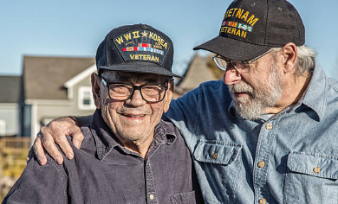
How do you know a veteran?
“Have you served” vs. “Are you a veteran”
Notes:
Key to asking this question. Why is it important? To frame this?

Slide 4
Recent US Wars & conflicts
World War II 1941-1945
Korea 1950-1953, armistice
Vietnam 1962-1973
Gulf War 1991
War on Terror 2001-Present
Notes:
Numerous other conflicts during this time:
Panama, Greneda, Kosovo, Hati, Lebanon, Lybia, Africa, etc.

Slide 5
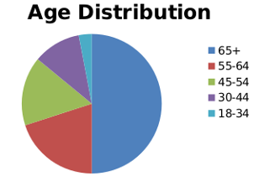
Maine veterans by the numbers
Total: 116,782
Female: 9,074
Male: 107,708
Wartime Veterans: 95,743
Gulf War: 34,341
Vietnam Era: 44,581
Korean Conflict: 10,853
World War II: 5,968
Peacetime: 21,039
Maine ranks 3rd in veterans per capita

Slide 6
How can veteran association help a non-veteran?
Possibly untapped compensation to the Veteran
Education benefits that could be available to the Veteran, spouse or authorized dependent

Slide 7
VA Disability Compensation
VA Disability Compensation is meant to compensate veterans for any decrease in income that may be caused by their disabilities and to provide health care for these conditions.
Service caused
Service aggravated
Line of Duty Determination

Slide 8
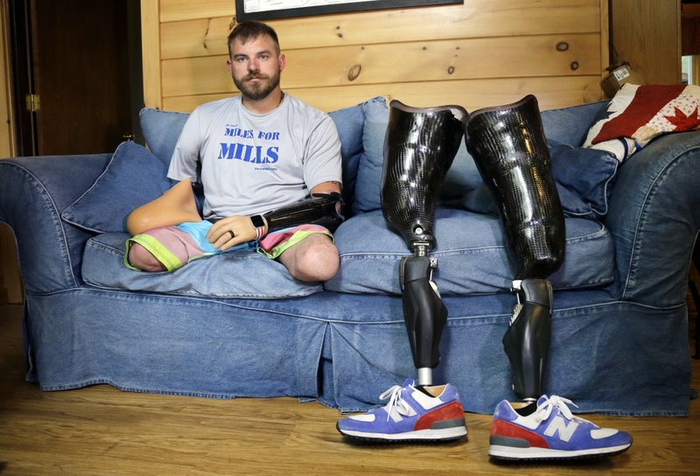
Service Caused
Did it happen as a result of official duty
or ancillary actions associated with
official duty?
Driving to work and getting
into an accident, and the associated
injuries, would likely be service
caused.
Breaking an ankle while working out off duty would also be
serviced caused (physical fitness is a duty requirement).

Slide 9
Service Aggravated
According to VA regulations, aggravation is defined as occurring under the following conditions:
A preexisting injury or disease will be considered to have been aggravated by active military, naval, or air service, where there is an increase in disability during such service, unless there is a specific finding that the increase in disability is due to the natural progress of the disease.

Slide 10
Line of Duty Determination
If your accident or injury was caused by your own willful misconduct, you will not be able to collect any benefits for the disability. Generally, alcohol and drug abuse is considered willful misconduct barring benefits for any resulting injuries, but in some cases, benefits will still be permitted if it is extremely clear that your use of substances did not cause the accident or injury.
If misconduct is suspected the military will conduct a Line of Duty investigation to determine if the military is responsible for the injury.

Slide 11
Veteran Education Benefits
Post 9/11 GI Bill Transfer
Dependents Education Assistance (DEA)
VA Dependent
Maine DEA
Marine Gunnery Sergeant Fry Scholarship
Alternative sources

Slide 12
Post 9/11 GI Bill (Chapter 33)
Can be used by veteran dependents if transferred prior to military separation
Up to in-state public university tuition paid
Monthly housing stipend (varies by school zip code)
USM Portland campus $2037
USM Lewiston-Auburn campus $1410
UMA Orono $1314
KVCC $1290
Online only rate: $825
Book stipend $1,000 per year
Yellow Ribbon Program

Slide 13
VA Dependents Education Assistance Program (Chapter 35)
Eligibility:
You must be the son, daughter or spouse of:
A Veteran who died or is permanently and totally disabled as the result of a service-connected disability.
A Veteran who died from any cause while such permanent and total service-connected disability was in existence.
A Servicemember missing in action or captured in line of duty by a hostile force.
A Servicemember forcibly detained or interned in line of duty by a foreign government or power.
A Servicemember who is hospitalized or receiving outpatient treatment for a service connected permanent and total disability and is likely to be discharged for that disability.

Slide 14
Dependents Education Assistance continued
Monthly payments prorated payment based on course load
Full time $1224
¾ time $967
½ time $710
¼ time $306
Possibly eligible for Dependency and Indemnity Compensation (DIC)

Slide 15
Disability and Indemnity Compensation (DIC)
What is DIC?
“Dependency and Indemnity Compensation (DIC) is a tax free monetary benefit paid to eligible survivors of military Servicemembers who died in the line of duty or eligible survivors of Veterans whose death resulted from a service-related injury or disease.”
Basic monthly allowance: $1,319
Additional allowances could add another $1,695 depending on many different variables and circumstances.

Slide 16
VA DIC Eligibility (Spouse)
The surviving spouse was:
Married to a Servicemember who died on active duty, active duty for training, or inactive duty training, OR
Validly married the Veteran before January 1, 1957, OR
Married the Veteran within 15 years of discharge from the period of military service in which the disease or injury that caused the Veteran's death began or was aggravated, OR
Was married to the Veteran for at least one year, OR
Had a child with the Veteran, AND
Cohabited with the Veteran continuously until the Veteran's death or, if separated, was not at fault for the separation, AND
Is not currently remarried

Slide 17
VA DIC Eligibility (Child)
Not included on the surviving spouse's DIC, AND
Unmarried, AND
Under age 18, or between the ages of 18 and 23 and attending school.

Slide 18
Maine DEA
Maine provides a 100% waiver of tuition and all related fees for spouses and dependents of veterans.
Schools covered under this program include the University of Maine System, Maine Community Colleges, and Maine Maritime Academy.
"Veteran" means any person who served in the military or naval forces of the United States and entered the service from this State or has been a resident of this State for 5 years immediately preceding application for aid and, if living, continues to reside in this State throughout the duration of benefits administered under the educational benefits program.

Slide 19
Marine Gunnery Sergeant Fry Scholarship
The Marine Gunnery Sergeant John David Fry Scholarship (Fry Scholarship) provides Post-9/11 GI Bill benefits to the children and surviving spouses of Servicemembers who died in the line of duty while on active duty after September 10, 2001.
In state tuition paid
Monthly housing stipend (varies by zip code)
USM Portland campus $2037
USM Lewiston-Auburn campus $1410
UMA Orono $1314
KVCC $1290
Online only rate: $825
Book stipend $1,000 per year

Slide 20
Fry Scholarship Eligibility
If you are eligible for both Fry Scholarship and DEA (Dependents Educational Assistance), you will be required to make an irrevocable election between the two programs when you apply.
Children are eligible as of their 18th birthday (unless they have already graduated high school).
Although surviving spouses do not have a time limit with which to use their benefits, they will lose eligibility to this benefit upon remarriage.

Slide 21
Conclusion
Many funds are available for Veterans and their sependents
Disability compensation could help augment Veteran income
Education benefits for some Veteran dependents
Post 9/11 GI Bill (if transferred)
VA Dependents Education Assistance
Maine Dependents Education Assistance
Marine Gunnery Sergeant Fry Scholarship
Eligibility is different for every program

Slide 22
Alternate sources of education benefits
Private scholarships specific to military and veteran dependents
Reserve Officer Training Corps programs in Maine
Army ROTC @ USM
Army and Navy ROTC @ UMA
Iraq and Afghanistan Service Grant or Additional Federal Pell Grant Funds
If your parent or guardian died as a result of military service in Iraq or Afghanistan after the events of 9/11, you may be eligible for additional aid.
If you meet the requirements above and are eligible to receive a Pell Grant, you will receive an Expected Family Contribution (EFC) of zero.

Slide 23
Questions?

